Slide 1
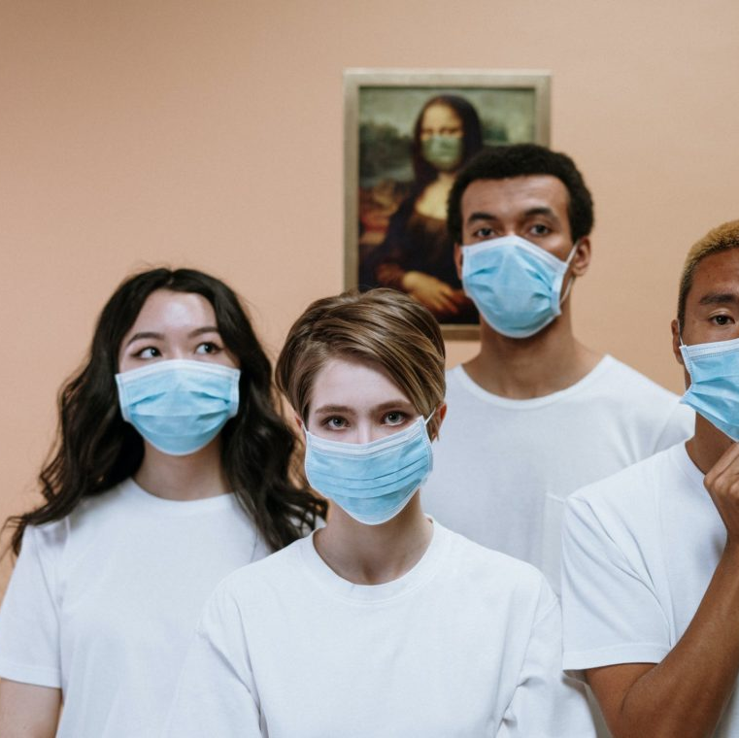
FACE MASK DETECTION
TEAM-5
This Photo by Unknown author is licensed under CC BY.

Slide 2
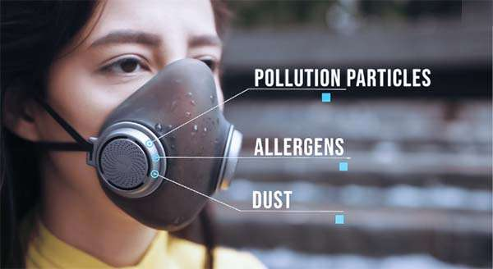
"AI is not a replacement for humans. It's here to augment human capability, to augment what we do, and ultimately allow us to do more."
- Fei-Fei Li
This Photo by Unknown author is licensed under CC BY-SA-NC.

Slide 3
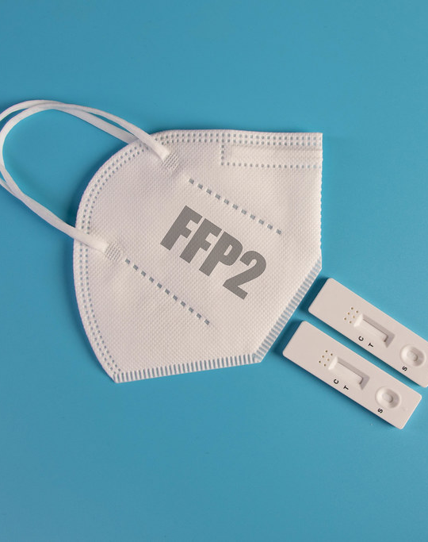
OUR TEAM
2103A52041 - A Yashaswini Gayathry
2103A52045 - B Abhinav Reddy
2103A52067 - S Sathwik Teja
This Photo by Unknown author is licensed under CC BY.

Slide 4
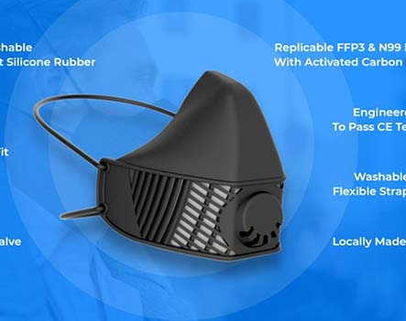
INTRODUCTION
An AI-powered face mask detection system is a computer vision technology that employs algorithms based on artificial intelligence to identify and classify individuals wearing masks in real-time video streams or images. This technology is frequently implemented in public spaces to enhance safety measures.
This Photo by Unknown author is licensed under CC BY-SA-NC.

Slide 5
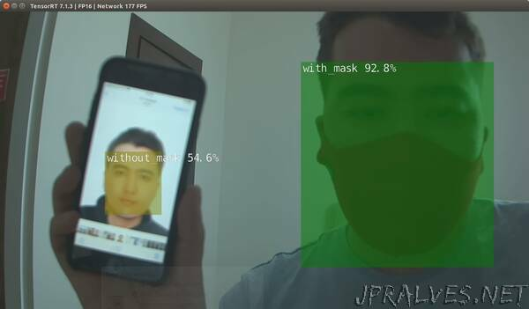
Data Conversion
Data conversion from image data to an array is an important preprocessing step in many machine learning and computer vision applications. When working with images, we typically represent them as matrices of pixel values. However, machine learning algorithms require numerical data in the form of arrays or tensors to be able to process the data effectively. One common method of converting image data to an array is by using OpenCV, an open-source computer vision library. OpenCV provides a range of functions to load, process, and manipulate image data in a variety of formats. To convert an image to an array using OpenCV, we first load the image using the imread() function. This function reads the image and returns a numpy array representation of the image in BGR format.
This Photo by Unknown author is licensed under CC BY-NC-ND.

Slide 6
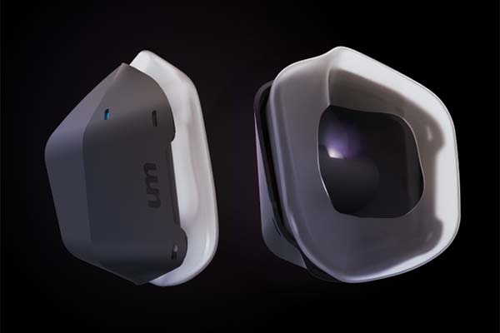
CODE
from google.colab import drive
drive.mount('/content/drive')
import cv2
DATADIR = "/content/drive/MyDrive/facemask-dataset/dataset"
CATEGORIES = ["with_mask", "without_mask"]
# Define image size
IMG_SIZE = 100
# Load image data into list
data = []
for category in CATEGORIES:
path = os.path.join(DATADIR, category)
class_num = CATEGORIES.index(category)
files = os.listdir(path)
random.shuffle(files)
files = files[:1500]
for img in files:
img_array = cv2.imread(os.path.join(path, img), cv2.IMREAD_COLOR)
img_resized = cv2.resize(img_array, (IMG_SIZE, IMG_SIZE))
data.append([img_resized, class_num])
This Photo by Unknown author is licensed under CC BY-SA-NC.

Slide 7
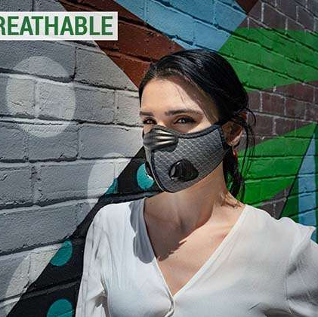
SUPERVISED LEARNING
Supervised learning is a type of machine learning where the algorithm is trained on labeled data, meaning data that is already categorized or classified. In the context of face mask detection systems with AI, supervised learning can be used to train a machine learning model to recognize whether a person is wearing mask or not and classify them.
To train a supervised learning model for face mask detection, a large dataset of labeled images of people with and without mask is required. This information is used to train the machine learning model to recognize whether a person is wearing mask or not and classify them.
This Photo by Unknown author is licensed under CC BY-SA-NC.

Slide 8
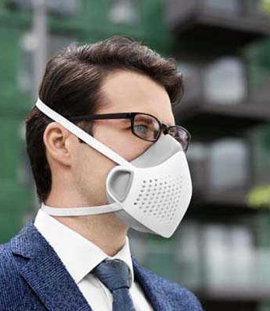
LOGISTIC REGRESSION
Logistic regression predicts the probability of a binary or categorical outcome using one or more independent variables. It transforms the variables into a probability value between 0 and 1 with a sigmoid function, which is then classified based on a threshold. It's widely used for outcome prediction, risk factor identification, and variable relationships. The process includes data preparation, model building, and evaluation.
This Photo by Unknown author is licensed under CC BY-SA-NC.

Slide 9
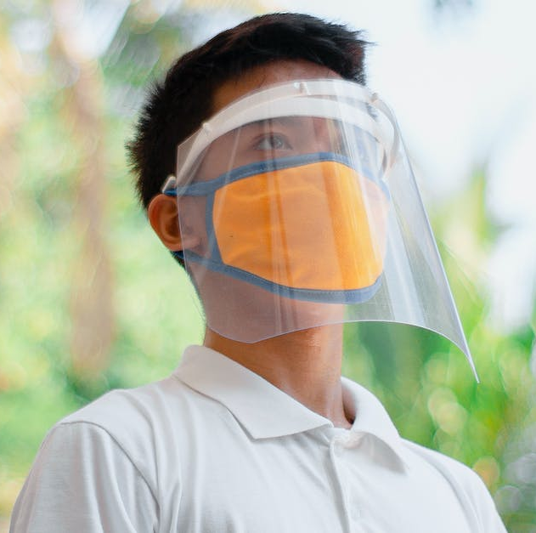
DECISION TREE
A decision tree is a popular algorithm in machine learning for classification and regression tasks. It uses a tree-like structure where each node represents a feature, branch represents a decision rule, and leaf node represents a decision or prediction. Decision trees can handle numerical and categorical data, are fast to train, and easy to interpret. However, overfitting can be an issue, which can be addressed by pruning and ensemble techniques like Random Forest.

Slide 10
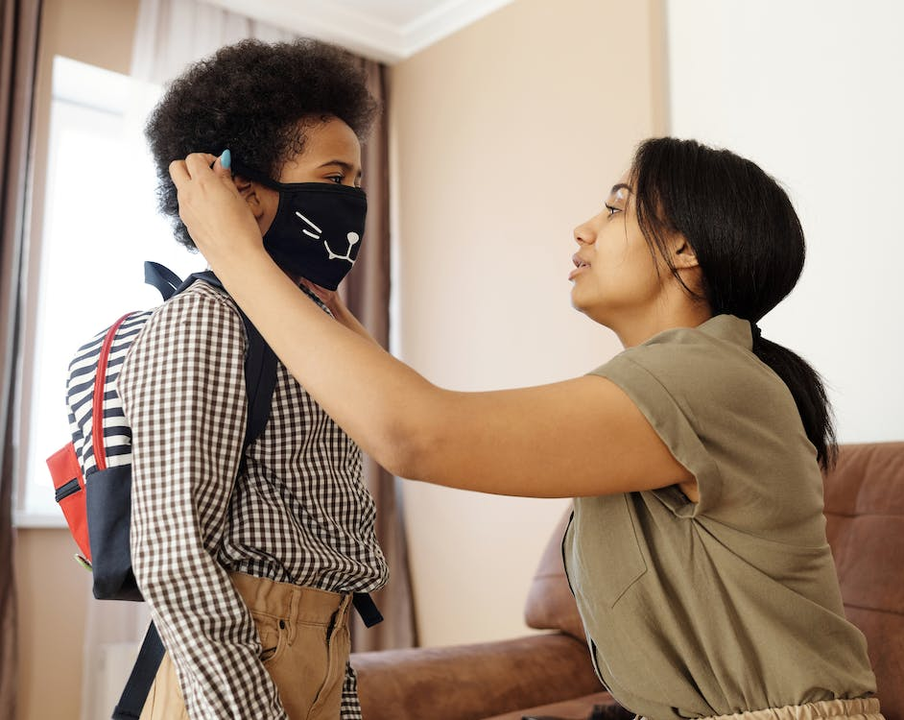
SUPPORT VECTOR MACHINE
SVM is a supervised learning algorithm for classification and regression. It finds the hyperplane that best separates classes, maximizing the margin between the closest data points of each class, called support vectors. SVM uses different kernel functions to map data to a higher-dimensional space, allowing easier class separation. SVM handles high-dimensional data and overfitting, but it can be computationally expensive and sensitive to hyperparameters. SVM is popular in image recognition, text classification, and bioinformatics due to its accuracy and versatility.

Slide 11
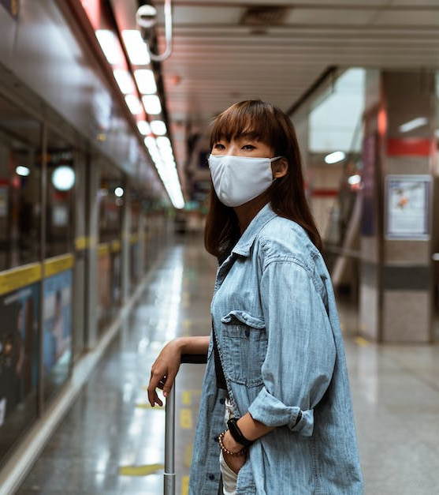
K-NEAREST NEIGHBORS
KNN, or k-nearest neighbors, is a machine learning algorithm used for classification and regression tasks. It identifies the k nearest neighbors to a given data point based on distance and uses their labels/values to predict the label/value of the new data point. KNN is non-parametric, making no assumptions about the data distribution. However, it can be sensitive to the choice of k and computationally expensive for large datasets.

Slide 12
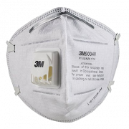
RANDOM FOREST
Random Forest is a popular ensemble learning algorithm used for classification and regression tasks. It combines multiple decision trees, each built using a random subset of features and data, to create a more accurate and stable model. Prediction is made by averaging or taking the majority vote of the individual tree predictions. Random Forests are flexible and widely used for tasks like image classification and customer churn prediction.
This Photo by Unknown author is licensed under CC BY-NC.

Slide 13
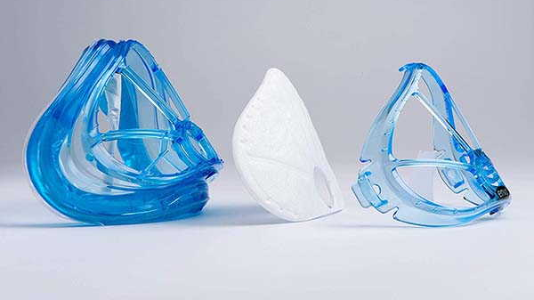
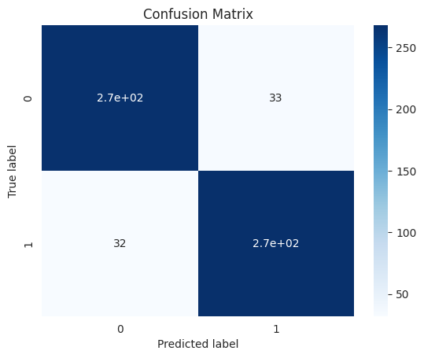
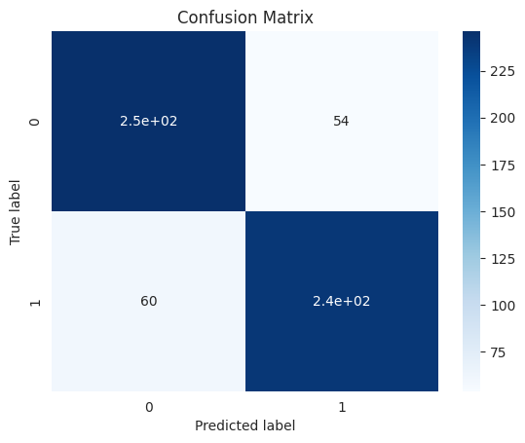
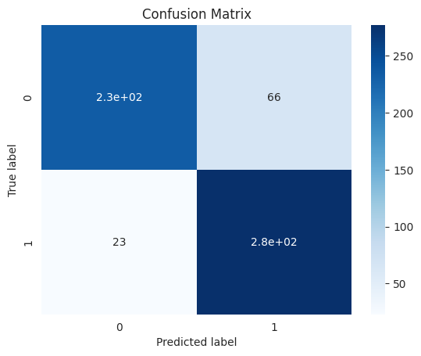

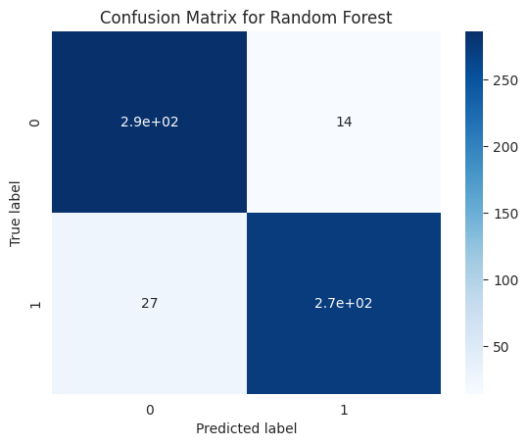
Logistic
Decision Tree
K- Nearest Neighbors
Support Vector Machine
Random Forest
This Photo by Unknown author is licensed under CC BY-SA-NC.

Slide 14
 | Logistic Regression | Decision Tree | K- Nearest Neighbor | Support Vector Machine | Random Forest
Accuracy | 0.9233333333333333 | 0.8316666666666667 | 0.8583333333333333 | 0.9566666666666667 | 0.935
Confusion Matrix | [[271 38] [ 8 283]] | [[254 55] [ 46 245]] | [[243 66] [ 19 272]] | [[292 17] [ 9 282]] | [[285 24] [ 15 276]]
This Photo by Unknown author is licensed under CC BY-SA-NC.

Slide 15
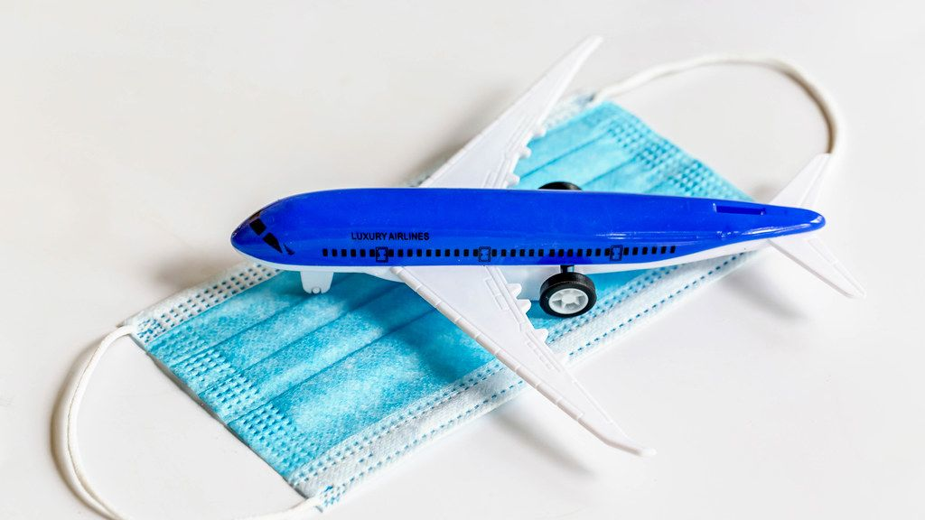
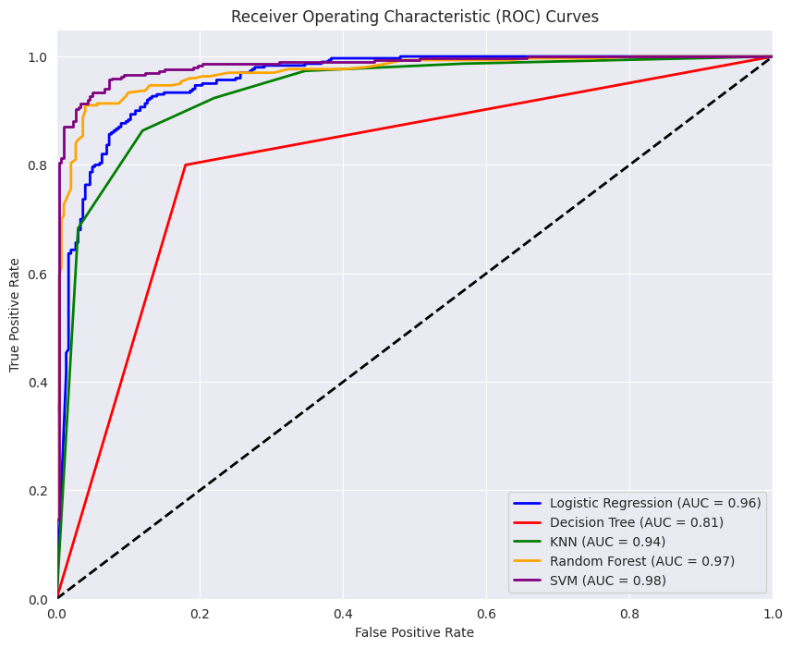
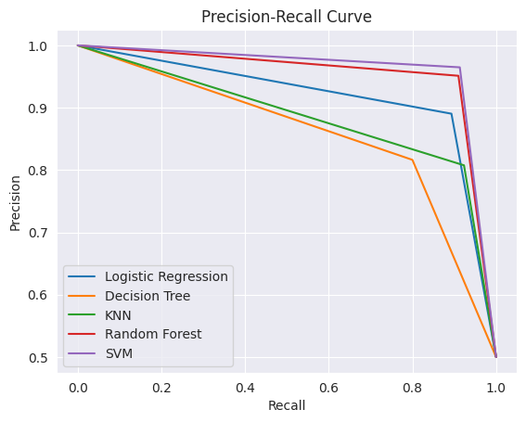
Precision-Recall Curve
Receiver Operating Characteristic Curves
This Photo by Unknown author is licensed under CC BY.

Slide 16
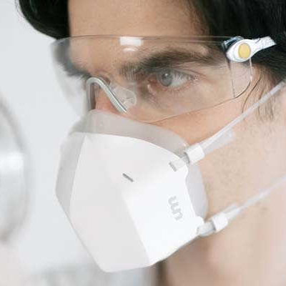
CONCLUSION
This project is a remarkable illustration of how AI and ML can address practical issues. Given the current situation, the capability to identify individuals wearing masks in real-time has become a crucial element of public safety.
This Photo by Unknown author is licensed under CC BY-SA-NC.

Slide 17
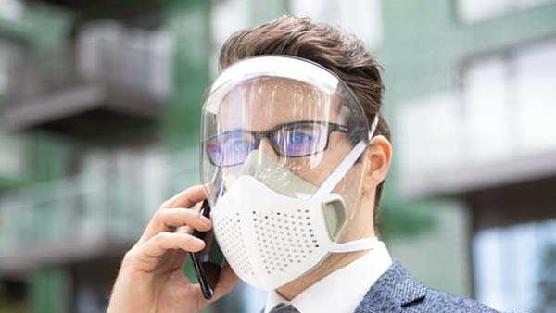
Thank you
This Photo by Unknown author is licensed under CC BY-SA-NC.

